Slide 1
Introduction to American University’s
New Messaging System:
Avaya Unified Messaging

Slide 2
About Avaya Unified Messaging
Avaya is American University’s new unified messaging system.
  Unified Messaging provides the same basic functionality of answering your incoming calls and recording messages, but with a wide range of additional features.
  Avaya Unified Messaging will provide one location for all of your e-mail, voice mail messages, and faxes to reside.
  Avaya will enable you to listen to your voice mail messages on your computer, telephone, or Blackberry.

Slide 3
Overview Information
Voice mail messages will be available by phone, but also sent to your e-mail inbox.
If you call into the system to check your messages, you will hear how many messages you have in both your voice mail and e-mail inbox. Then, you can have the system read them back to you.
Deleting a voice mail or e-mail message from your e-mail will also delete it from your voice mail, and vice versa.
  You can annotate, save, and file a voice mail message indefinitely by dragging and dropping it into a folder on your computer.

Slide 4
Setting Up Your Mailbox
Avaya will prompt you to initialize your mailbox the first time you access the system.
To set up your mailbox:
  Dial the ACCESS NUMBER at either 3880 from a campus telephone or (202) 885-3880 from off campus.
  For the first time login, enter your TEMPORARY PASSWORD followed by the Pound (#) sign. Contact the IT Help Desk if you are unsure of your temporary password.
  Follow the prompts to set up the following:
    Enter a NEW PASSWORD.
      Note: New passwords must be at least 4 digits, cannot be your extension number, cannot be consecutive or reverse consecutive numbers, and cannot be 4 of the same number.
    Record your NAME, or accept the default recording.
    Record your “PLEASE HOLD” prompt. The Please Hold prompt informs callers of the extension they selected when they are being transferred.
    Record your PERSONAL GREETING.

Slide 5
Accessing Your Mailbox
Once your initial greetings are set up, you can access your mailbox several ways:
  From your office phone:
    Dial the ACCESS NUMBER, 3880.
    When you hear your name, enter your PASSWORD.
  From a campus phone:
    Dial your EXTENSION, e.g 2243.
      When your greeting answers, press the * key twice.
    Enter your PASSWORD and press the # key.
  From outside the office:
    Dial 202-885-3880.
    Press the # key, when the system answers.
    Enter your MAILBOX NUMBER.
    Enter your PASSWORD and press the # key.

Slide 6
Reviewing Your Messages
After you have entered your password, the system will tell you how many new and saved voice mail and e-mail messages you have.
  Press 1 to review your messages.
    Press 1 to listen to your new voice messages.
    Press 2 to listen to your new e-mail messages.

Slide 7
Managing Your Greetings
Avaya allows you to record up to nine optional voice mail greetings.
To set up greeting messages, press 4 at the Main Menu to access the PERSONAL CONFIGURATION.
Then, press 1 for the GREETINGS MENU.
  The Greetings Menu contains the most commonly accessed personal greetings:
      Press 1 for the PERSONAL GREETING
      Press 2 for the EXTENDED ABSENCE GREETING
      Press 3 for the OPTIONAL GREETINGS
      Press 5 for the PLEASE HOLD PROMPT
      Press 6 for the NAME PROMPT

Slide 8
Creating Personal Distribution Lists
To activate the call handling feature, press 4 at the Main Menu to access the PERSONAL CONFIGURATION.
Then, press 6 for the PERSONAL DISTRIBUTION LIST MENU.
  The Personal Distribution List menu includes:
    Press 1 to CREATE LIST
    Press 2 to EDIT LIST
    Press 3 to DELETE LIST
    Press 4 to BROWSE ACTIVE LISTS

Slide 9
Voice Mail Tips
To leave a Message for a Person Without Ringing His/Her Phone:
  Dial 3880. Press the * key, and then the # key twice.
  Enter the desired EXTENSION NUMBER.
To Transfer a Caller Directly to Voice Mail:
  Press the TRANSFER button on your desk phone.
  Dial 3880.
  Press the * key, and then the # key twice.
  Enter the desired EXTENSION NUMBER.
  Press the TRANSFER button to complete the transfer.

Slide 10
Voice Mail Tips
To skip listening to a message and delete it:
  Press 3 and 3 again to fast-forward to end.
  Then, press 7 to delete.
To dial another extension:
  Then, press * to return to the main menu.
  Press 9 to call another.

Slide 11


About the Lotus Notes Interface
All voice mail will be stored in your Lotus Notes mail file.
Voice mail messages can now be handled like an e-mail message; they can be filed, saved, or archived as needed.
Voice mail messages appear in your inbox designated by a phone icon. You will see the Sender’s name or AU Voice Mail & Fax as the Sender’s Name, the telephone number, and the length of the message.
Voice mail messages are stored in your Inbox and, in Views -> Voice Inbox.

Slide 12
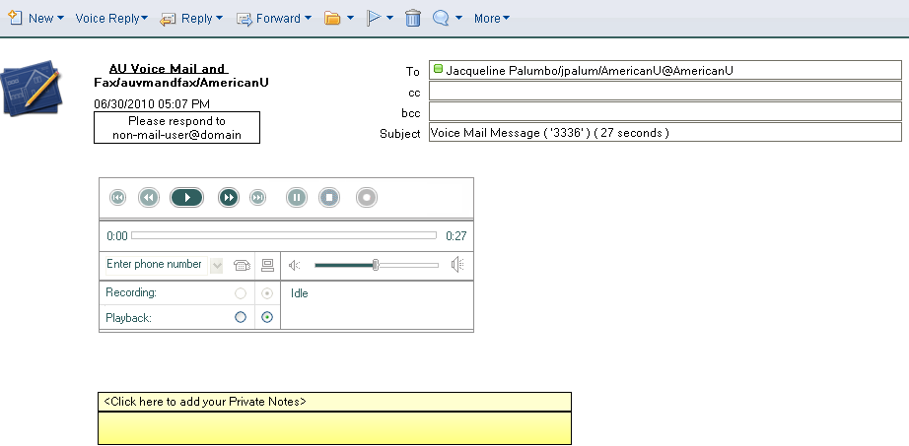
Using the Lotus Notes Interface
When a voice mail message is opened, the voice player is loaded.
  The voice player allows you to listen to the message from the desktop through your computer’s speakers or a headset. It can also be redirected to play to your phone.

Slide 13
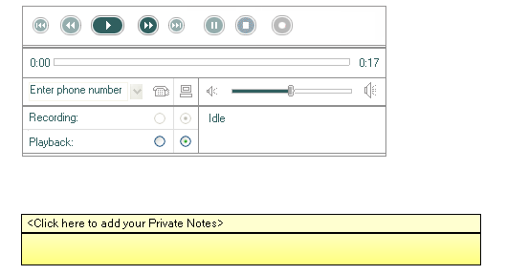
Playing a Message
Click the PLAY button to listen to the message.
Please note: If the radio button is highlighted to PLAYBACK on the computer or via telephone and:
  if the Computer is selected, the sound will play through the computer’s speakers.
  if the Telephone is selected, you will be prompted to enter your extension. Then, your phone will ring to play the message. You can also forward the call to another campus extension.

Slide 14
Annotating a Message
From the menu bar, you have the option to create a new voice mail message, create a voice reply, forward the voice mail message, and move the message into a folder.

Slide 15
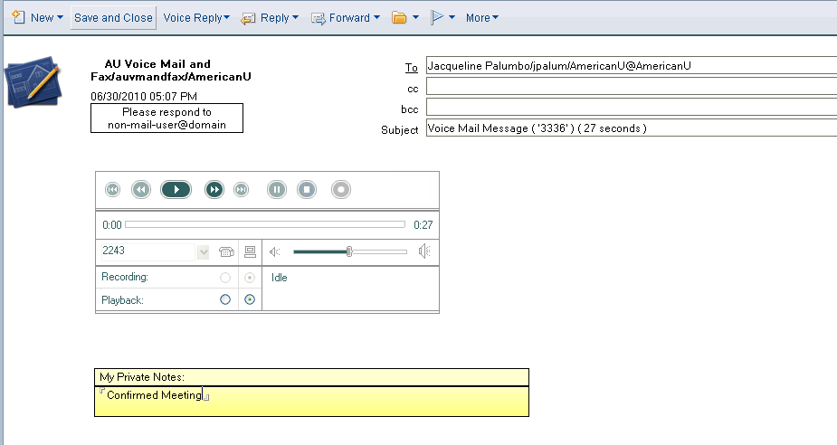
Annotating a Message
You can also click to add private notes to your voice mail message. Click the SAVE and CLOSE button on the menu bar to save your notes.

Slide 16
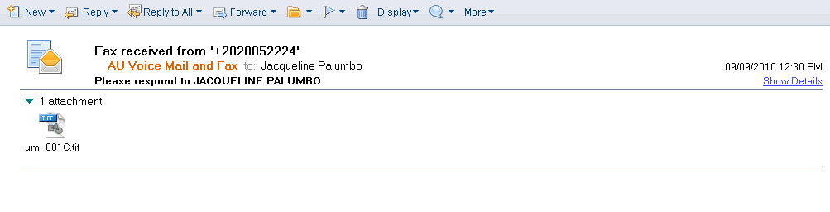
Receiving Faxes
You can now receive fax messages directly in your inbox. Your phone number will serve as your inbound fax number.

Slide 17
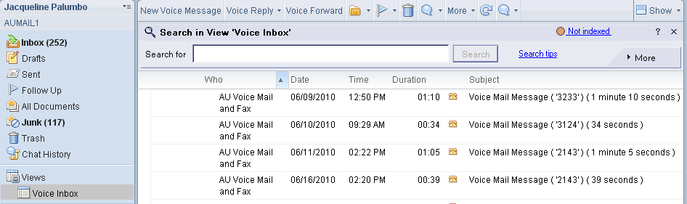
Locating Your Voice Mail Messages
Voice mail messages will be automatically stored in the VOICE INBOX view in your Mail Navigation Pane.
If you delete a voice mail message from your e-mail, it will also delete it from your voice mail.

Slide 18
Using Avaya with WebMail
Voice messages may also be accessed in Lotus Notes iNotes which is the webmail version of Lotus Notes Client.
Currently, the Avaya player is only available in the Internet Explorer browser.
Users who utilize Firefox, Chrome, or Safari as their primary WebMail interface will receive their voice messages as .WAV file attachments. Users must contact the OIT Help Desk to request this option.

Slide 19
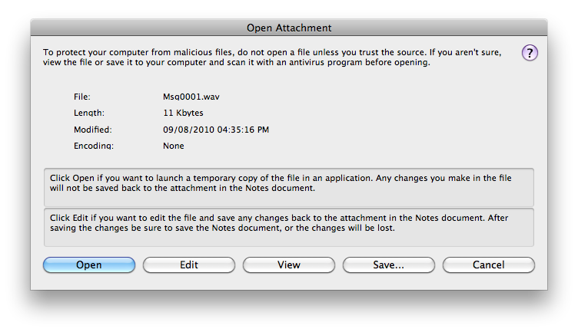
Using Avaya with a Macintosh
If you access the Lotus Notes client on a Macintosh computer, and you wish to use the Avaya interface, please contact the OIT Help Desk.
New voice mail messages will appear in the Inbox of your Lotus Notes client as an unread email with a .WAV attachment.
To listen to your voice mail message, you can double click on the .WAV attachment and choose OPEN. This will open the message for playback in your default media playback program.

Slide 20
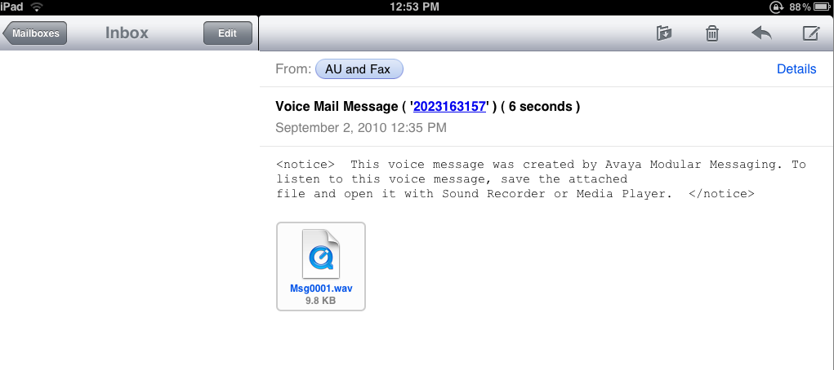
Using Avaya with Lotus Notes Traveler
You can access Avaya through any device that has Lotus Notes Traveler installed on it.
The voice message will be sent as a .WAV file attachment.

Slide 21
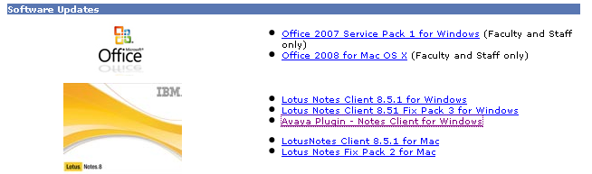
Installing the Avaya Interface
The Avaya software is available now for you to install. Please be aware that the Avaya program will become functional only after your group’s implementation is complete.
  Login to the AU Web Portal at https://my.american.edu and click the TECHNOLOGY link. Then, from the Personalized Links column, click DOWNLOAD SOFTWARE.
  Click AYAVA PLUGIN – NOTES CLIENT FOR WINDOWS in the Software Updates section of the webpage.
  Follow the prompts to install the Avaya plugin.

Slide 22

Questions ?

Slide 23
Getting Help
IT Help Desk
helpdesk@american.edu
202-885-2550
IM: AskAmericanUHelp

