Slide 1
Introduction to American University’s
New Messaging System:
Avaya Unified Messaging

Slide 2
About Avaya Unified Messaging
Avaya is American University’s new unified messaging system.
  Offers same basic functionality of answering calls and recording messages, but with a wide range of additional features.
  Provides one location for e-mail, voice mail messages, and faxes.
  Listen to voice mail messages on your computer, telephone, Blackberry, and other handheld devices.

Slide 3
Overview Information
Voice mail messages will be available by phone, and also in your e-mail inbox.
Hear how many messages you have in both your voice mail and e-mail inbox.
Have the Avaya system read e-mail messages to you.
  Add notes, drag/drop into folders, save your voice mail messages indefinitely.

Slide 4
Setting Up Your Mailbox
  Access your mailbox:
      Dial 3880 from a campus phone or (202) 885-3880 from off campus.
    or....
      Press the MESSAGE button on your phone.
  For the first time login, enter your TEMPORARY PASSWORD followed by the Pound (#) sign. Contact the OIT Help Desk (x2550) if you are unsure of your temporary password.
  Follow the prompts to:
    Enter a NEW PASSWORD.
      Note: must be at least 4 digits, cannot be your extension number, cannot be consecutive or reverse consecutive numbers, and cannot be 4 of the same number.
    Record your NAME, or accept the default recording.
    Record your PLEASE HOLD prompt. (informs callers of the extension they selected when being transferred)
    Record your PERSONAL GREETING.

Slide 5
Accessing Your Mailbox
  From your office phone:
      Dial the ACCESS NUMBER, 3880, and enter your PASSWORD.
    or...
      Press the MESSAGE button on your phone and enter your PASSWORD.
  From a campus phone:
      Dial your EXTENSION; when your greeting answers, press the * key twice.
      Then, enter your PASSWORD and press the # key.
  From outside the office:
      Dial 202-885-3880.
      Press the # key when the system answers.
      Enter your MAILBOX NUMBER.
      Enter your PASSWORD and press the # key.

Slide 6
Phone Features
After you have entered your password, the system will tell you:
How many new and saved voice mail messages you have.
How many new and saved e-mail messages you have.
  Press 1 to review your messages.
    Press 1 to listen to your new voice messages.
    Press 2 to listen to your new e-mail messages.
Avaya allows you to record up to nine optional greetings:
To set up greeting messages, press 4 at the Main Menu to access PERSONAL CONFIGURATION.

Slide 7
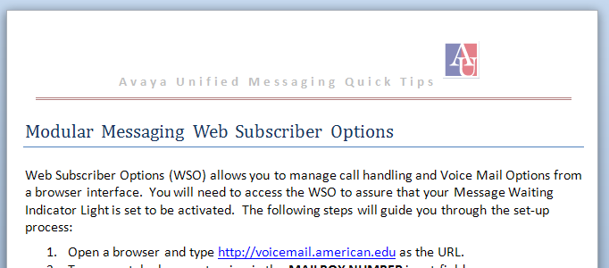
Message Indicator Light
By default, the indicator light will not display to indicate new voice mail.
You can change this option at: http://voicemail.american.edu
Indicator light will not turn off until you’ve reached the end of the message:
    Listen to the entire message. Press 7 to delete, or 9 to save the message, or the light will not go off.
    Press 3,3 to fast-forward to the end of the message.
    Mark the message as READ in your e-mail inbox.
    Be sure to get the handout:

Slide 8
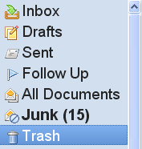
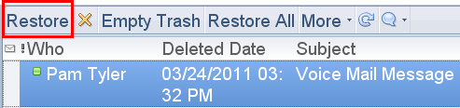
Deleting Voice Mail
If you delete a voice mail from your phone, the voice mail message will also be deleted from your Lotus Notes mail file.
If you delete a voice mail message from your Lotus Notes mail file, the voice mail will also be deleted from your phone.
Restore from Lotus Notes TRASH folder if you want to retrieve the voice mail message.

Slide 9
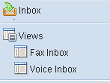
The Lotus Notes Interface
Voice mail will be stored in your Lotus Notes mail file:
  Inbox
  Views Voice Inbox
Voice mail messages can now be handled like e-mail messages:
    Add private notes
    Drag/drop into a folder
    Save indefinitely
Voice mail messages designated by a phone icon, .

Slide 10
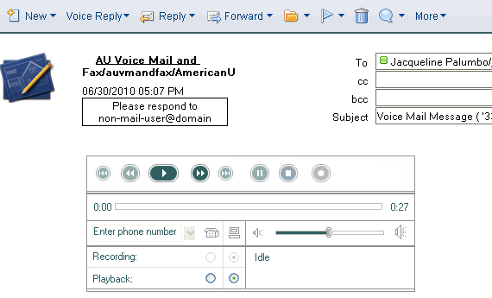
Using the Lotus Notes Interface
When a voice mail message is opened, the voice player is loaded.
    Select COMPUTER PLAYBACK, , to listen to the message through your computer’s speakers or a headset.
    Select PHONE PLAYBACK, , to forward the message to your phone.

Slide 11
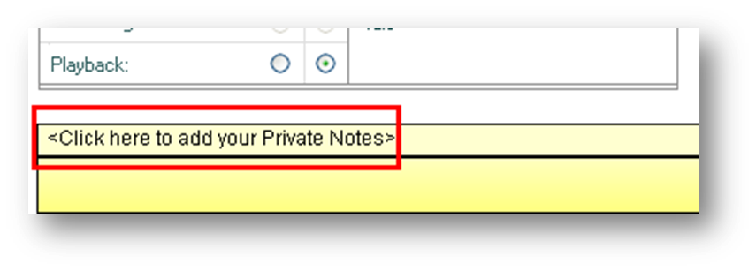
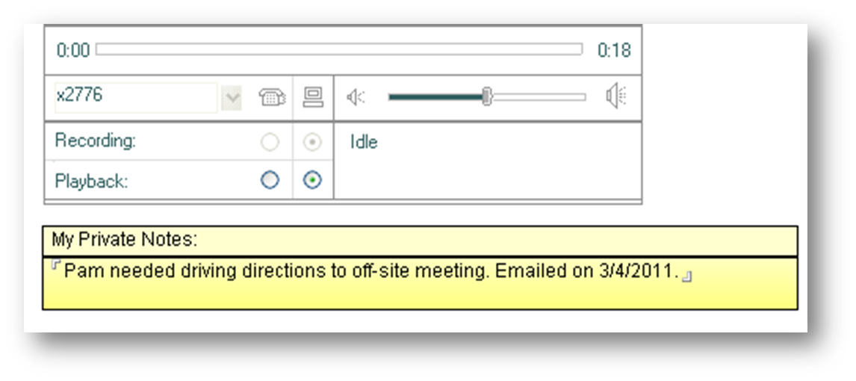
Annotating a Message
Add a note to your voice mail message. Click the SAVE and CLOSE button on the menu bar to save your note.

Slide 12
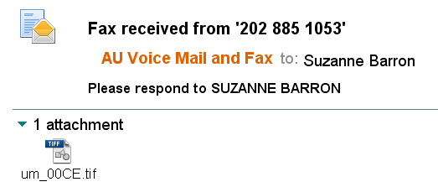
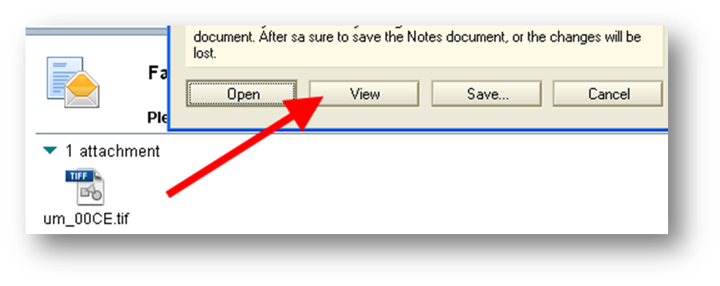
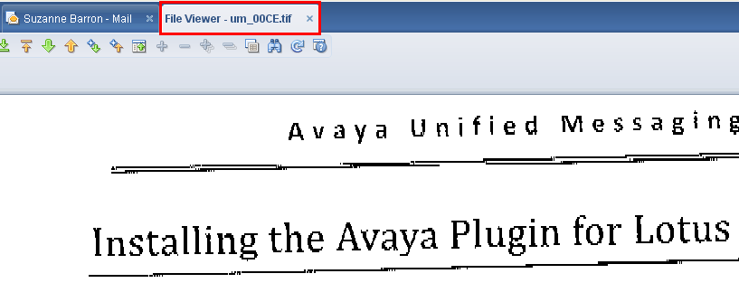
Receiving Faxes
Receive fax messages directly to your inbox. Your phone number will serve as your inbound fax number.

Slide 13
Forwarding Messages
If you forward your Lotus e-mail to another e-mail service, your voice mail will not be saved on your phone, because Lotus Notes is now the storage repository for voice mail messages, rather than the phone system.
Please contact the OIT Help Desk if you forward your e-mail, but would still like to receive voice mail messages on your phone.

Slide 14
Using Avaya with WebMail
Voice messages may also be accessed in Lotus Notes iNotes, the webmail version of Lotus Notes Client.
Currently, the Avaya player is only available in the Internet Explorer browser.
Users who utilize Firefox, Chrome, or Safari as their primary WebMail interface will receive their voice messages as .WAV file attachments.
  Users must contact the OIT Help Desk to request this option.
  If you request this option, then the Avaya player will be unavailable in Lotus Notes Client; you will receive voice messages as .WAV file attachments.

Slide 15
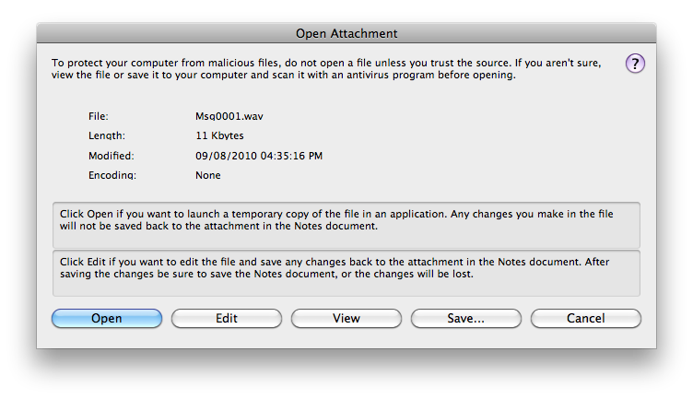
Using Avaya with a Macintosh
Users who use a Macintosh computer will receive their voice messages as .WAV file attachments.
Macintosh Lotus Notes and WebMail Users must contact the OIT Help Desk to request this option.
To listen to a voice mail message, double click on the .WAV attachment and choose OPEN. This will open the message for playback in your default media playback program.

Slide 16
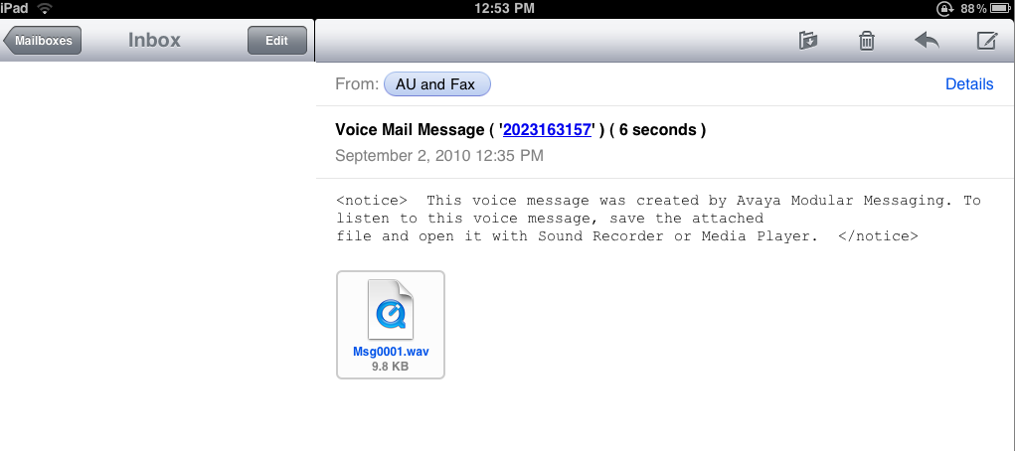
Using Avaya with Lotus Notes Traveler
You can access Avaya through any device that has Lotus Notes Traveler installed on it.
The voice message will be sent as a .WAV file attachment.

Slide 17
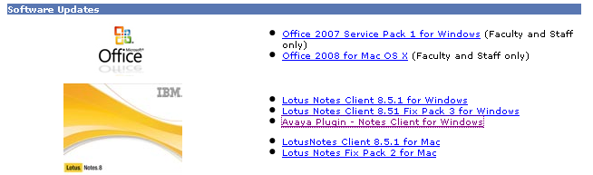
Installing the Avaya Interface
The Avaya player is available now for installation and will become functional after the Avaya implementation is complete.
    Login to the AU Web Portal and click the TECHNOLOGY link. Then, from the Personalized Links column, click DOWNLOAD SOFTWARE.
    Click AYAVA PLUGIN – NOTES CLIENT FOR WINDOWS in the Software Updates section of the webpage.
    After the plugin downloads, you must run the file to complete the installation.

Slide 18
Getting Help
IT Help Desk
helpdesk@american.edu
202-885-2550
IM: AskAmericanUHelp

Slide 19
Avaya Unified Messaging
Thank you for attending!

