Slide 1

Research Grants Financial Reporting
Presented by: Office of Information Technology

Slide 2
Research Grants Reporting
Project Background:
In response to the # 1 recommendation of the Research Grants Infrastructure Task Force, a cross-functional project team was assembled in March, 2011 to "Provide the funded faculty with reports and/or data around account information from Datatel, in a timely manner, including encumbering such expense as salaries, fringe benefits, and F&A charges."

Slide 3
Research Grants Reporting
Project Background:
The Research Grants Reporting (RGR) Project Team collaborated to produce a set of web-based reports through our business intelligence (BI) reporting tool, Microstrategy.

Slide 4
Research Grants Reporting
American University utilizes the MicroStrategy Business Intelligence application to provide financial reporting on research grants.
This course will teach you how to look at the budget, expenses and unobligated amounts for your research grants. You will learn how to:
  View expenditures
  View encumbrances
  Learn about the option to model unobligated funds into the future

Slide 5
Research Grants Reporting
Log on to the myau.american.edu Portal, then expand the TECHNOLOGY link under Personalized links.
Select BI REPORTING. Access to view this link is restricted to those granted the security class.

Slide 6
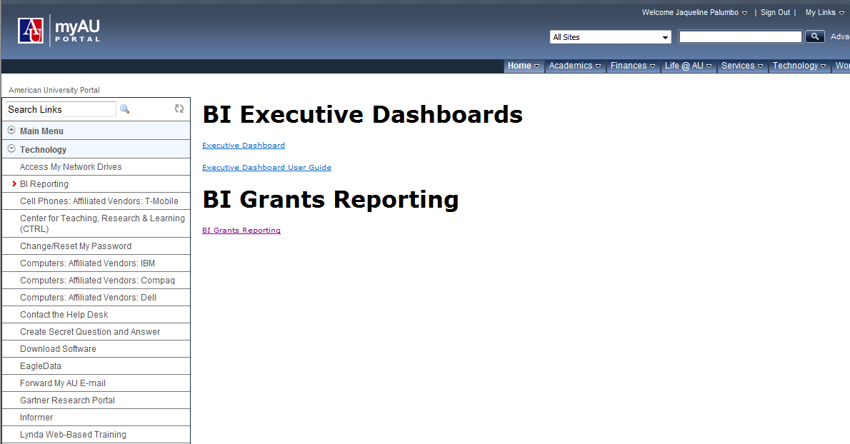
Research Grants Reporting
Double-click on the BI GRANTS REPORTING link.
BI Grants Reporting

Slide 7
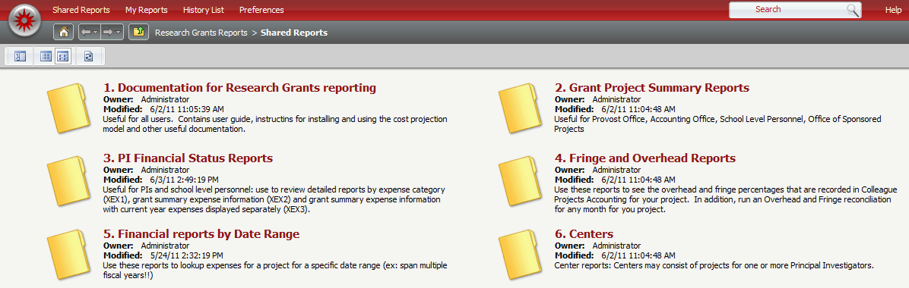
Research Grants Reporting
The Research Grants Reporting window will open.

Slide 8
PI Financial Status Reports
There are multiple financial status reports available for your review.
For this training session, we will focus on how to run several types of reports.
These steps are transferrable to the other financial status reports.

Slide 9
PI Financial Status Reports
Single-click on PI Financial Status Reports.

Slide 10
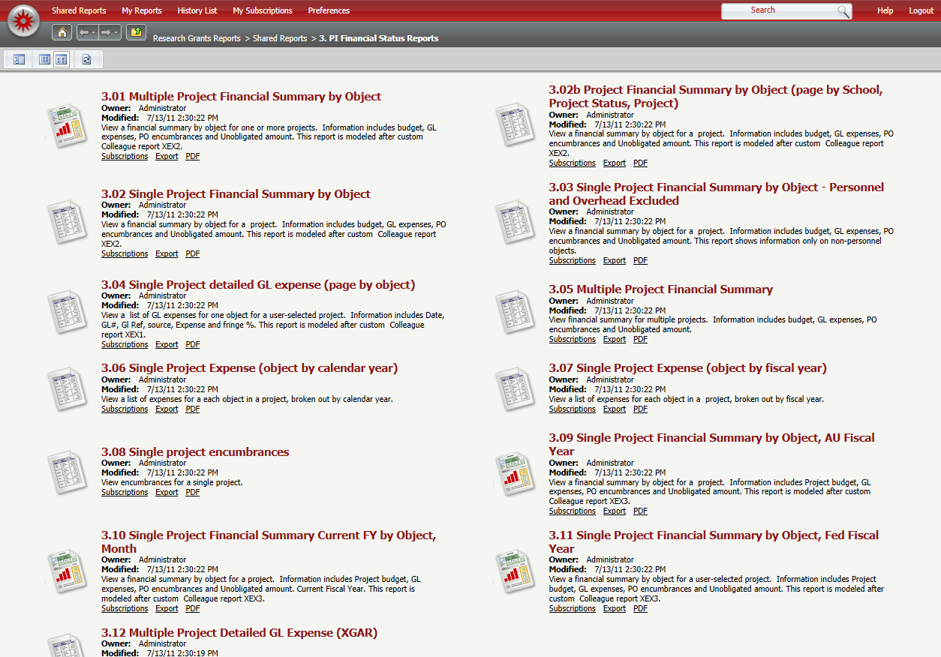
PI Financial Status Reports
The reports menu will open. Two types of reports are available: Chart reports and Grid reports.
We will review how to work with each type of report.
Chart Report icon
Grid Report icon

Slide 11
Multiple Project Financial Summary by Object
Single-click on 3.01 MULTIPLE PROJECT FINANCIAL SUMMARY BY OBJECT.

Slide 12
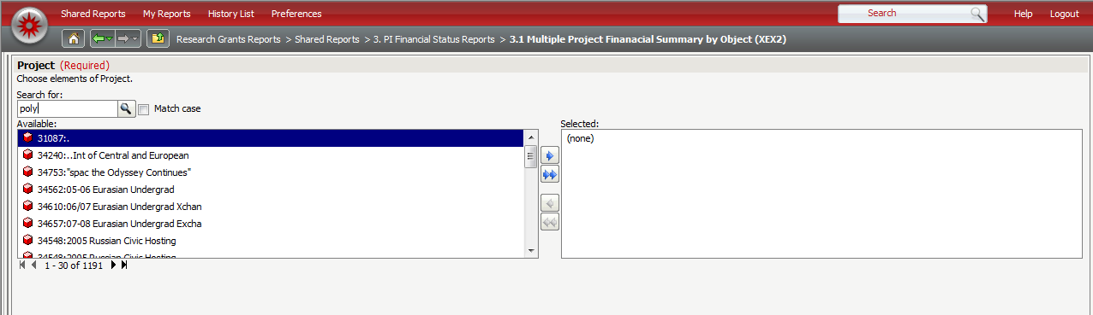
Multiple Project Financial Summary by Object
Enter the Project Number or Project Name in the Search for box, then click the SEARCH button, .

Slide 13
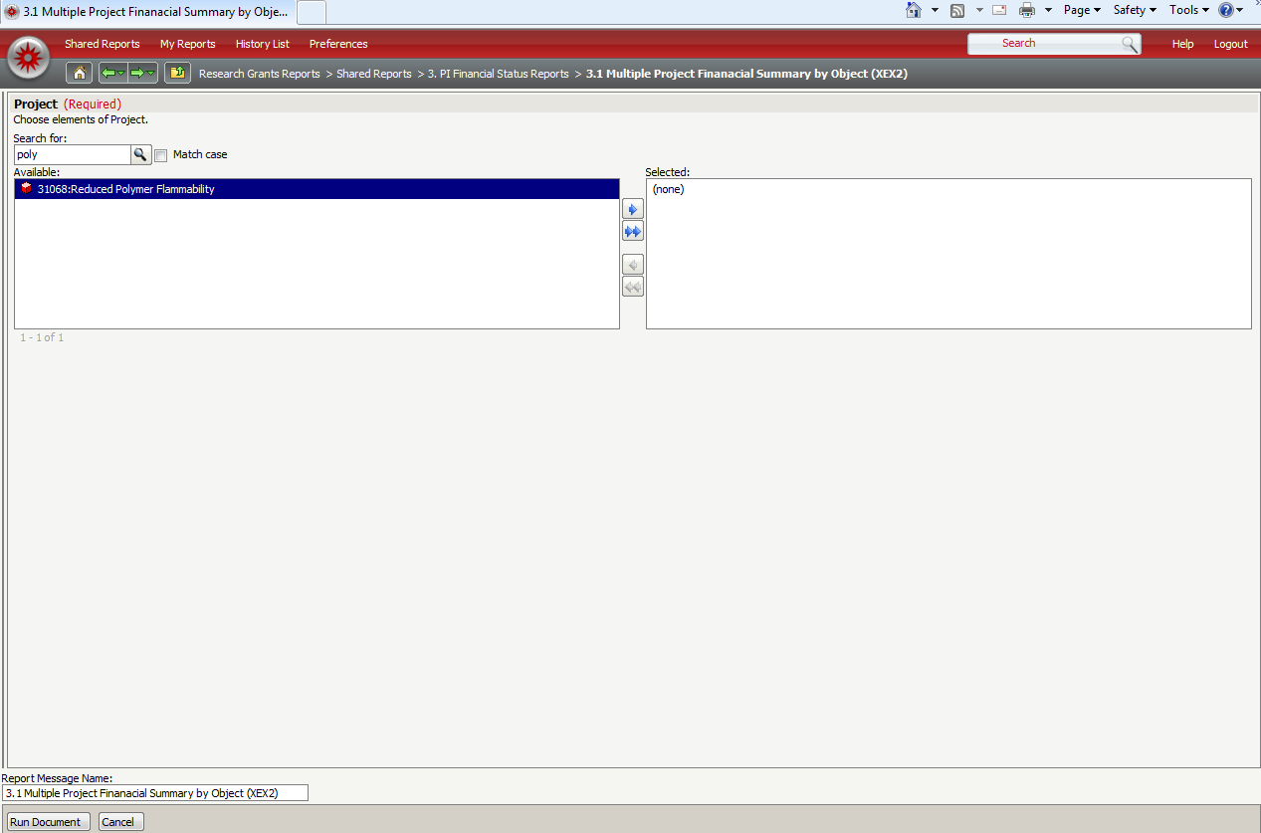
Multiple Project Financial Summary by Object
The data selection window will open. Click the RIGHT ARROW button to select the data, then the RUN DOCUMENT button to run the report.
Click the RIGHT ARROW button to select the data.
Click the RUN DOCUMENT button to run the report.

Slide 14


Navigating through a Chart Report
Use the Menu buttons to:
Return to Homepage
Navigate forward or backward
Move up one level
Use the Toolbar buttons to:
Export to Excel, PDF, HTML, or Flash
Print
View Full Screen Mode

Slide 15
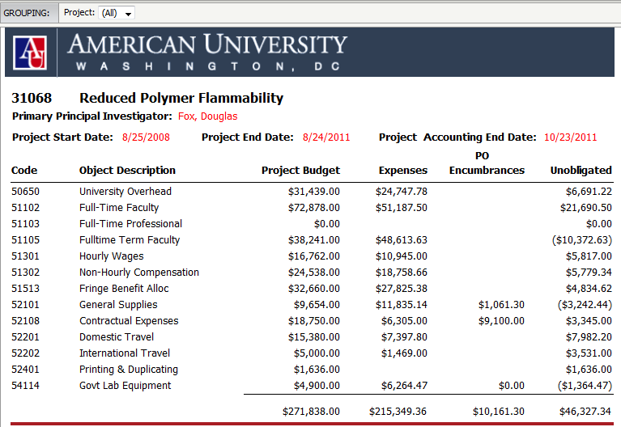
Multiple Project Financial Summary by Object
The report will display the name of the project, the project number, the Primary Principal Investigator and the accounting end date for the grant.
Project Start Date
Person directly in charge of project
Accounting End Date
Project End Date

Slide 16
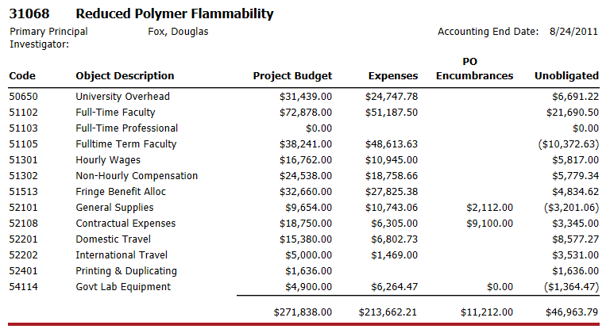
Multiple Project Financial Summary by Object
This report displays inception to date General Ledger summary information for your grant (XEX2).
This information includes the:
Object Code
  Object Description
  Project Budget
  Expenses
  PO Encumbrances
  Unobligated amount

Slide 17
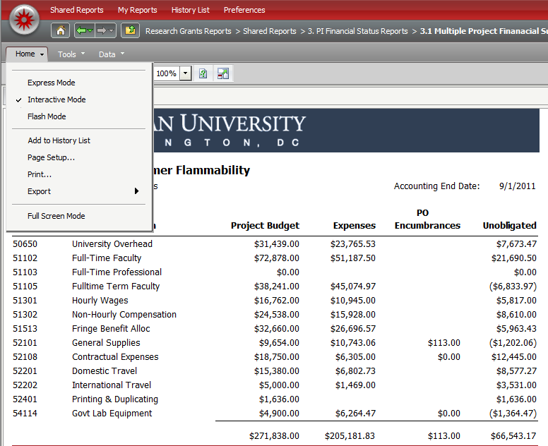
Printing the Report
By default, reports will print in portrait mode. To switch to landscape mode: Click the HOME tab, then select PAGE SETUP.
Page Setup

Slide 18
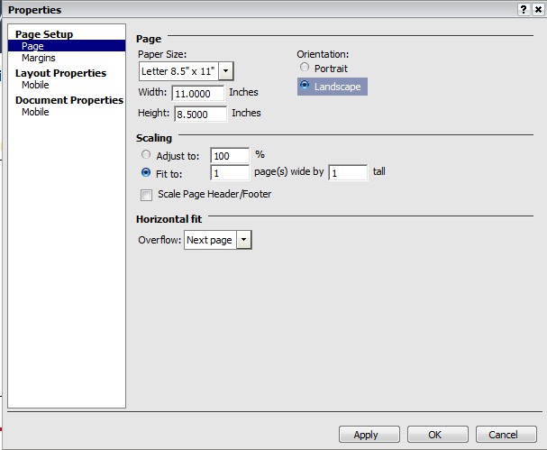
Printing the Report
Select the LANDSCAPE orientation.
Change the scaling to Fit to 1 pages(s) wide by 1 tall.
Click APPLY, then OK.

Slide 19
Single Project detailed GL expense
Single-click on 3.04 Single Project detailed GL expense (page by object) (XEX1).

Slide 20
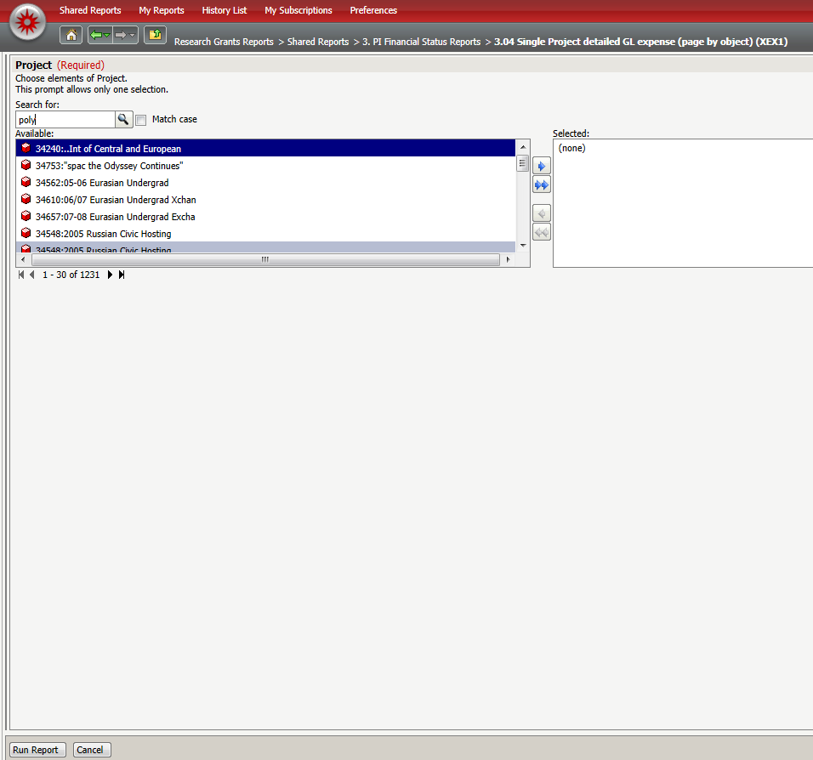
Single Project detailed GL expense
Enter the Project Number or Project Name in the Search for box, then click the SEARCH button. Click the RIGHT ARROW button to select the data.
Click RUN REPORT.
Click the RIGHT ARROW button to select the data.
Click the RUN REPORT button to run the report.

Slide 21

Navigating through a Grid Report
Use the Menu buttons to:
Return to Homepage
Navigate forward or backward
Move up one level
Use the Toolbar buttons to:
Export to PDF
Print
View Full Screen Mode
Export to Excel

Slide 22
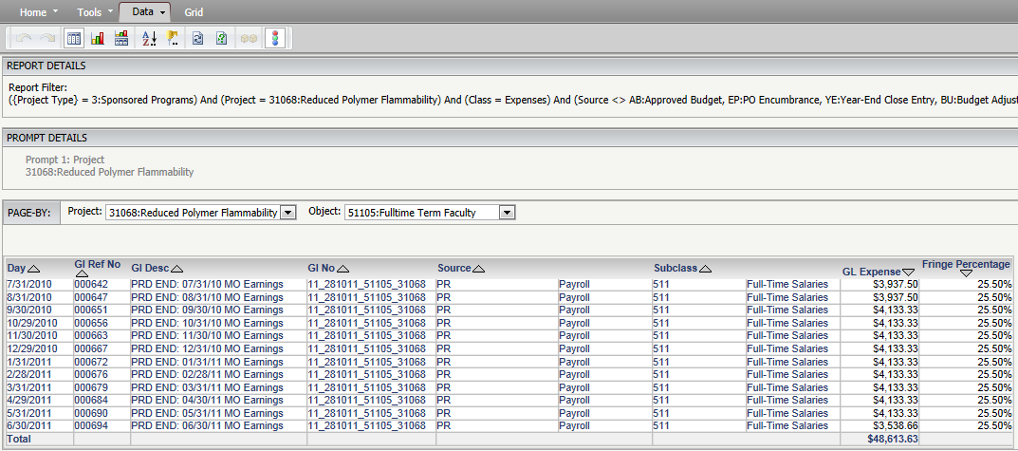
Single Project detailed GL expense
The report will run in Grid format.
The default Project and Object code will be displayed.
Project Code
Object Code

Slide 23
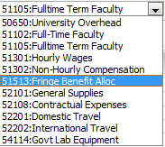
Single Project detailed GL expense
You can click the drop-down arrow to select another display view.
Click to select Object code

Slide 24
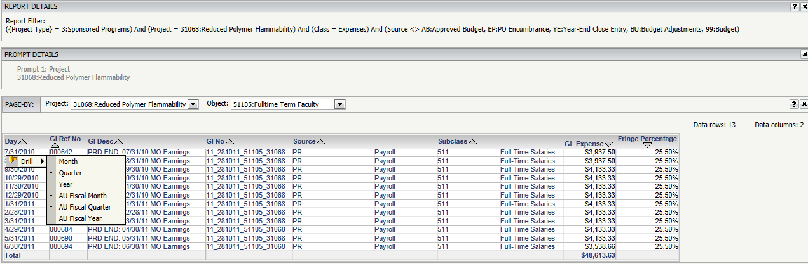
Single Project detailed GL expense
You can also drill down to select a more detailed view by right-clicking on the DAY column, selecting DRILL, then selecting a view.
Drill function

Slide 25
Single Project detailed GL expense
You can continue to drill down further, or click the back button, , to return to the previous view.
Note that the REPORT DETAILS field will show your drill path.
Drill path

Slide 26
Single Project detailed GL expense
You can sort report data by clicking on the SORT ARROW on a column.
Sort Arrow

Slide 27
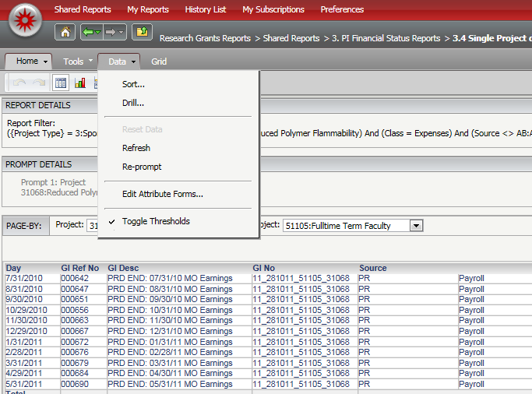
Single Project detailed GL expense
You can also click on the DATA tab, then select SORT, or use the SORT button on the toolbar, .
Sort Feature

Slide 28
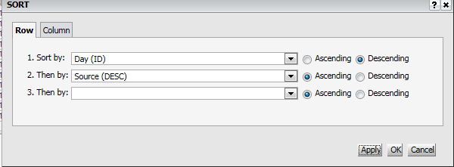
Single Project detailed GL expense (XEX1)
Select the sort criteria, then click APPLY or OK to accept the change.

Slide 29
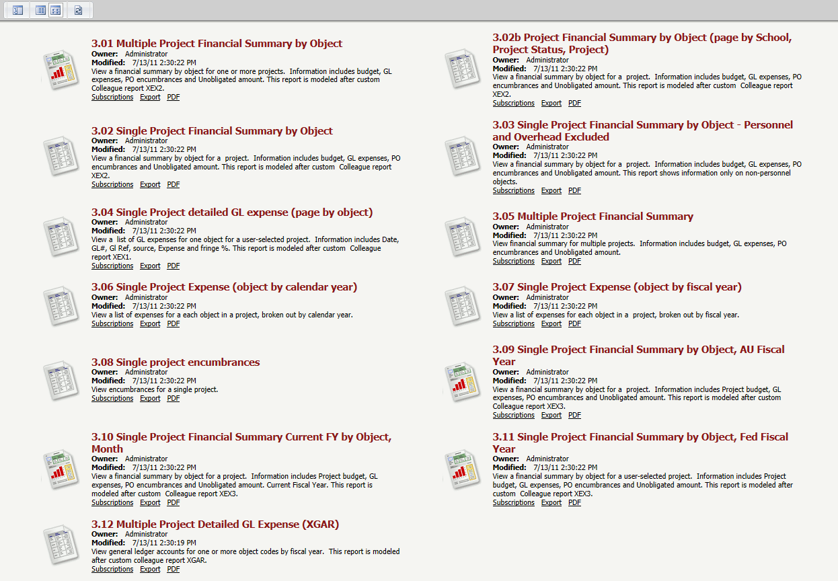
Single Project Financial Summary
Single-click on 3.10 Single Project Financial Summary Current FY by Object, Month.

Slide 30
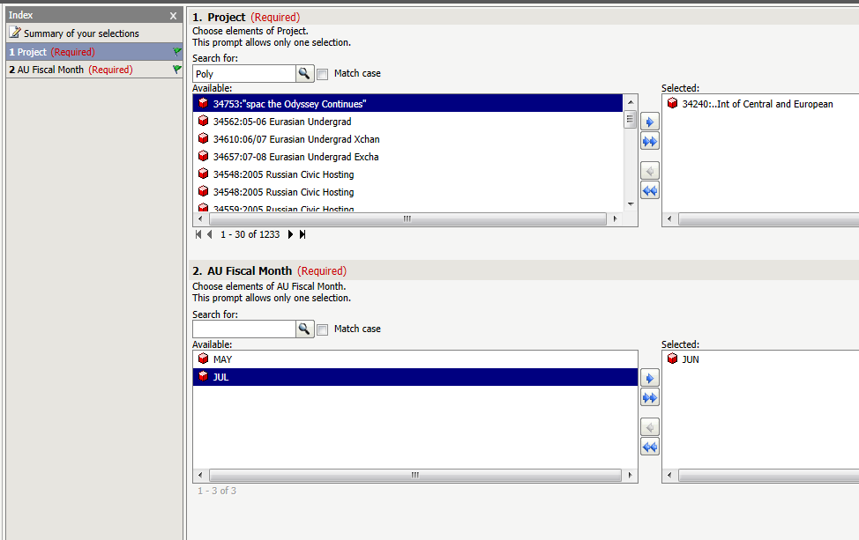
Single Project Financial Summary
Enter the Project Number or Project Name in the Search for box, then click the SEARCH button. Click the RIGHT ARROW button to select the data.
Select the FISCAL MONTH. Click the RIGHT ARROW button to select the data.
Click RUN REPORT.
Select Project and Fiscal Month

Slide 31
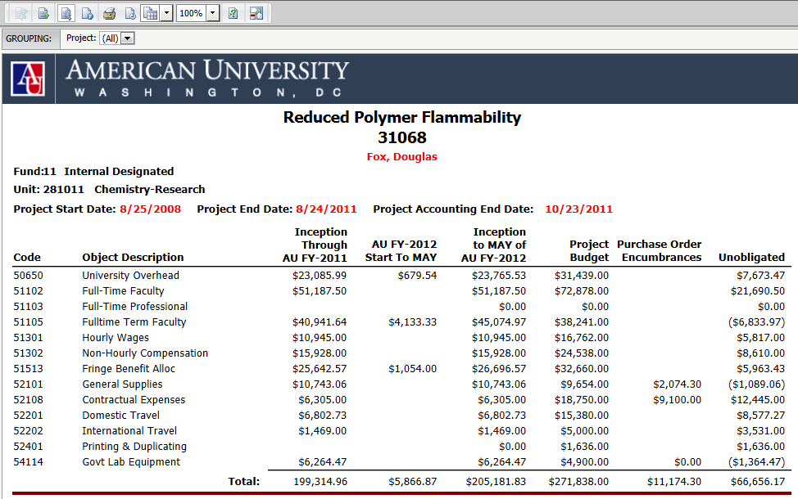
Single Project Financial Summary
The data will display in a Chart Report.

Slide 32
Multiple Project Detailed GL Expense (XGAR)
Single-click on 3.12 Multiple Project Detailed GL Expense (XGAR).

Slide 33
Multiple Project Detailed GL Expense (XGAR)
Enter the Project Number or Project Name in the Search for box, then click the SEARCH button. Click the RIGHT ARROW button to select the data.
Click RUN REPORT.
Click the RIGHT ARROW button to select the data.
Click the RUN REPORT button to run the report.

Slide 34
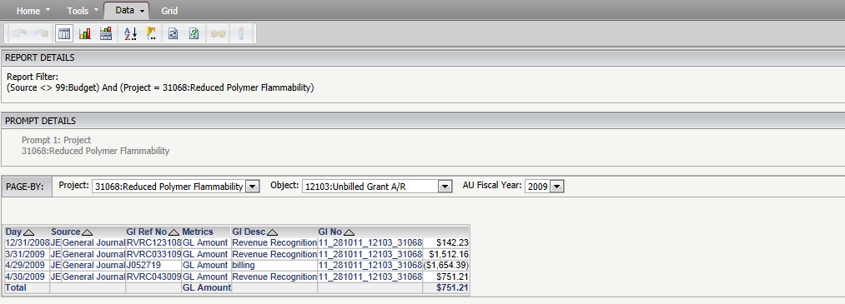
Multiple Project Detailed GL Expense (XGAR)
This report will display detailed activity for a selected Project and Object code.
Select an OBJECT CODE and a FISCAL YEAR.
Object Code
Fiscal Year

Slide 35
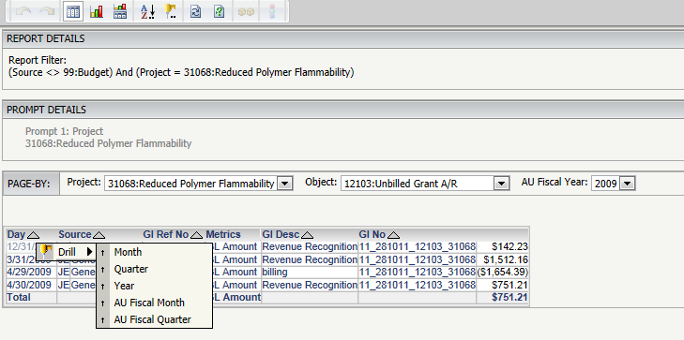
Multiple Project Detailed GL Expense (XGAR)
You may click on the Date column to drill to additional detail.
Drill Function

Slide 36
Financial Reports by Date Range
The Financial Reports by Date Range allows you to customize your reports by date range.

Slide 37
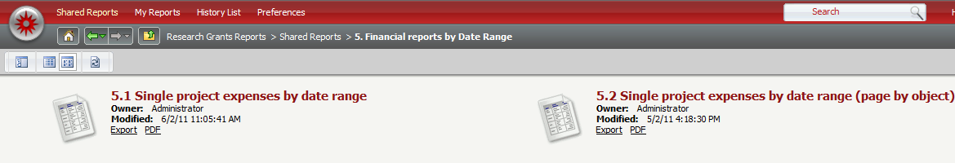
Financial Reports by Date Range
There are two grid report options:
  Single Project expenses by date range.
  Single Project expenses by date range (page by object).
We will focus on 5.1 Single Project Expenses by Date Range.

Slide 38
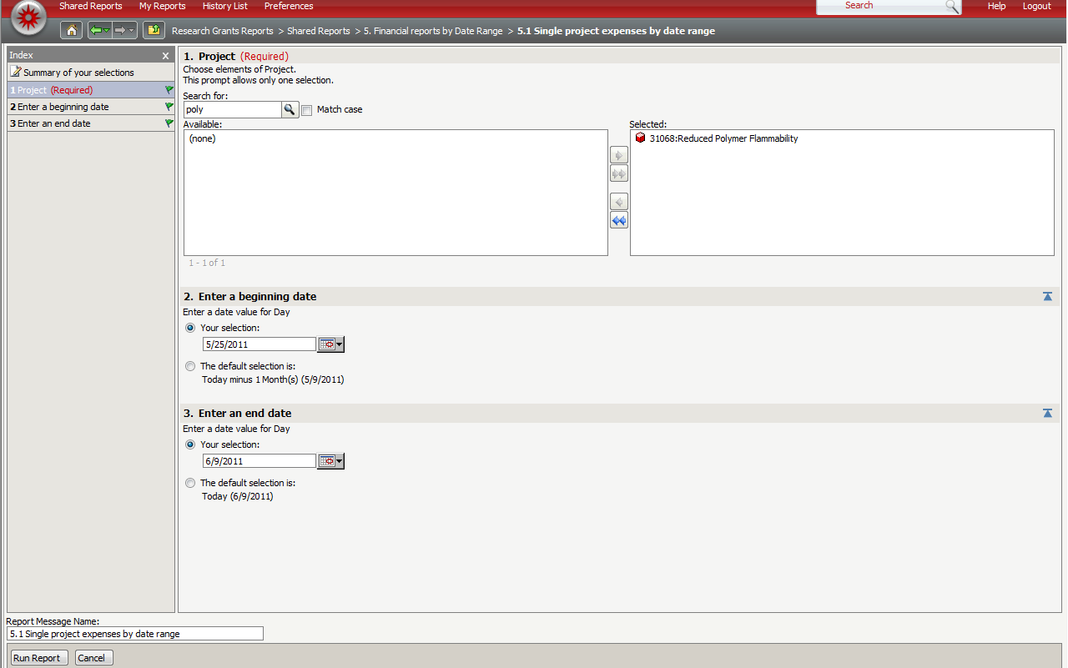
  Single Project expenses by date range
Enter the Project Number or Project Name, then, select the Beginning and End date. Click the RIGHT ARROW button to select the data.
Click RUN REPORT.
Click the RIGHT ARROW button to select the data.
Select the Beginning and Ending date.
Click the RUN REPORT button to run the report.

Slide 39
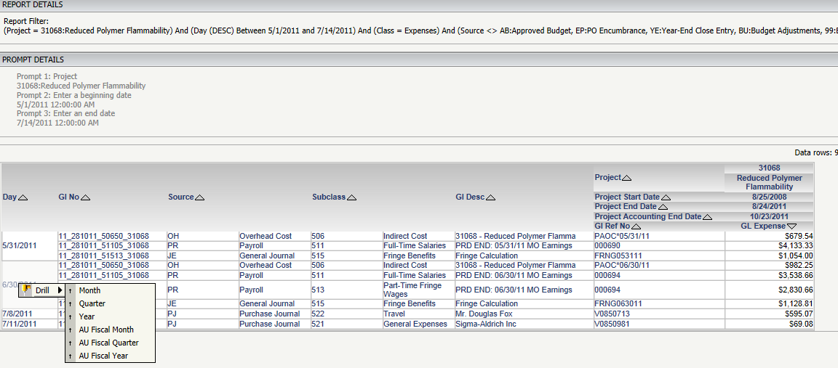
  Single Project expenses by date range
You may drill down for additional details.

Slide 40
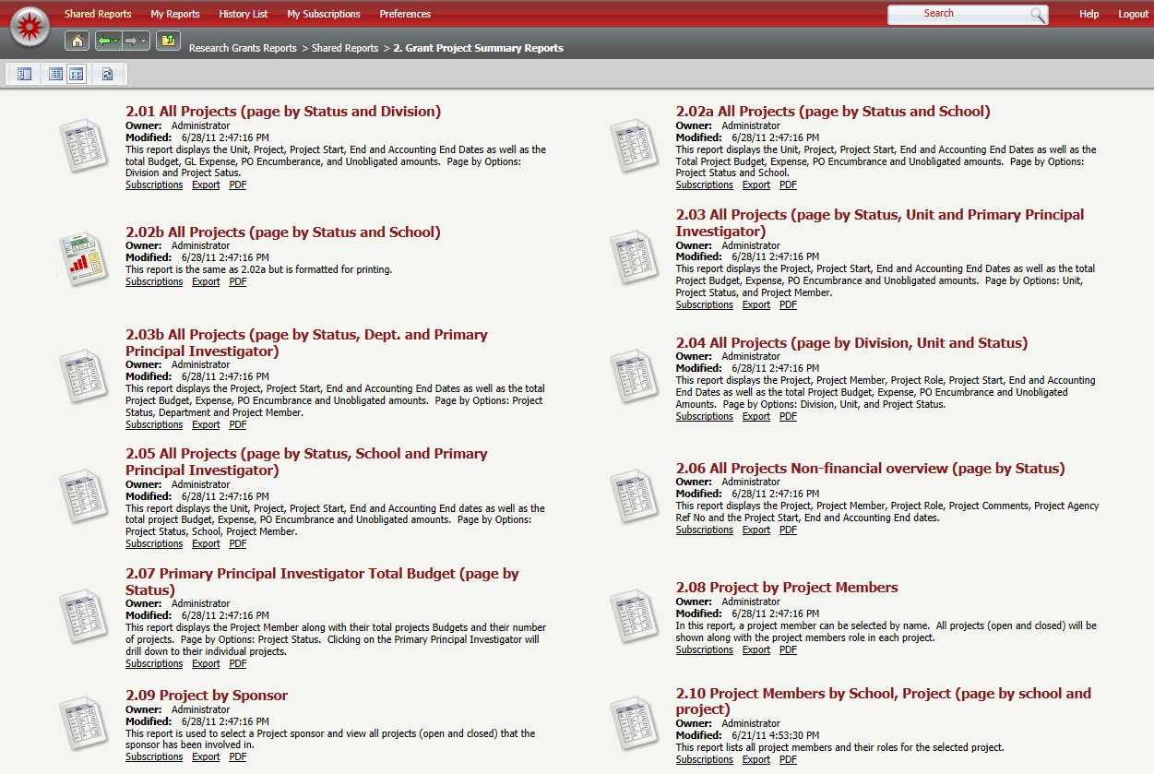
Grant Project Summary Reports
There are multiple Grant Project Summary reports available for your review.

Slide 41
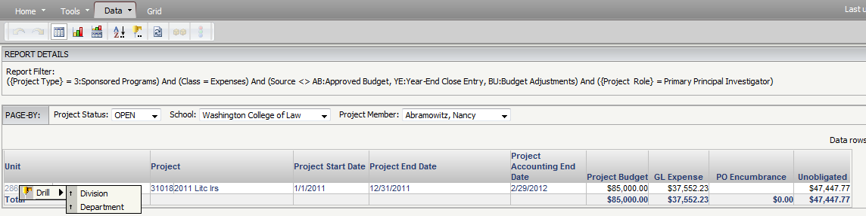
Grant Project Summary Reports
We will focus on 2.05 All Projects (page by Status, Dept. and Primary Principal Investigator).
Single-click on the report, then select the School or Project Member by clicking on the drop-down arrow.
You can right-click on the Total column, then select DRILL to view Division and Department data.

Slide 42
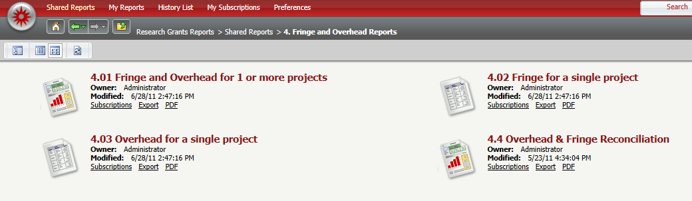
Fringe and Overhead Reports
The Research Grants Reporting program contains four Fringe and Overhead reports.
We will focus first on report 4.02 Fringe for a Single Project.
Single-click on 4.02 FRINGE FOR A SINGLE PROJECT.

Slide 43
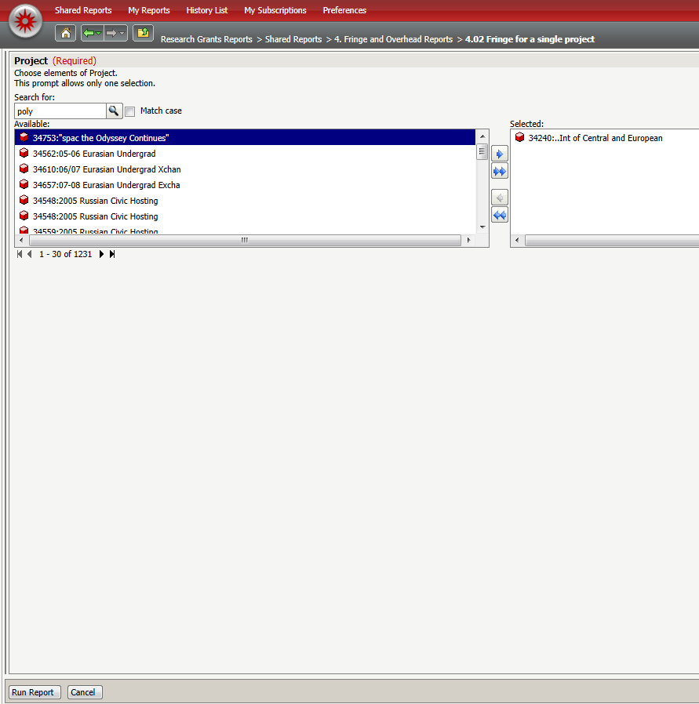
Fringe and Overhead Reports
Enter the Project Number or Project Name in the Search for box, then click the SEARCH button. Click the RIGHT ARROW button to select the data.
Click RUN REPORT.
Click the RIGHT ARROW button to select the data.
Click the RUN REPORT button to run the report.

Slide 44
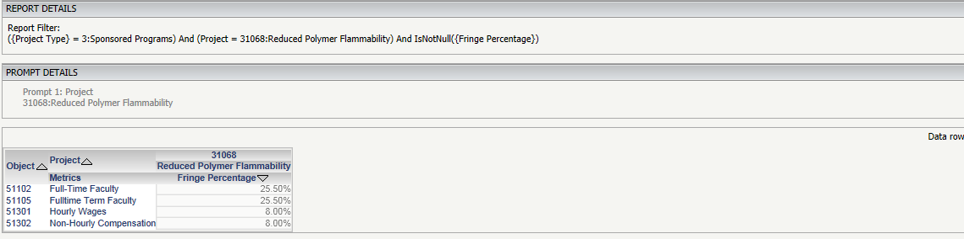
Fringe and Overhead Reports
The report will run.
This report does not have drillable fields.

Slide 45
Fringe and Overhead Reports
Single-click on 4.4 FRINGE Overhead & Fringe Reconciliation.

Slide 46
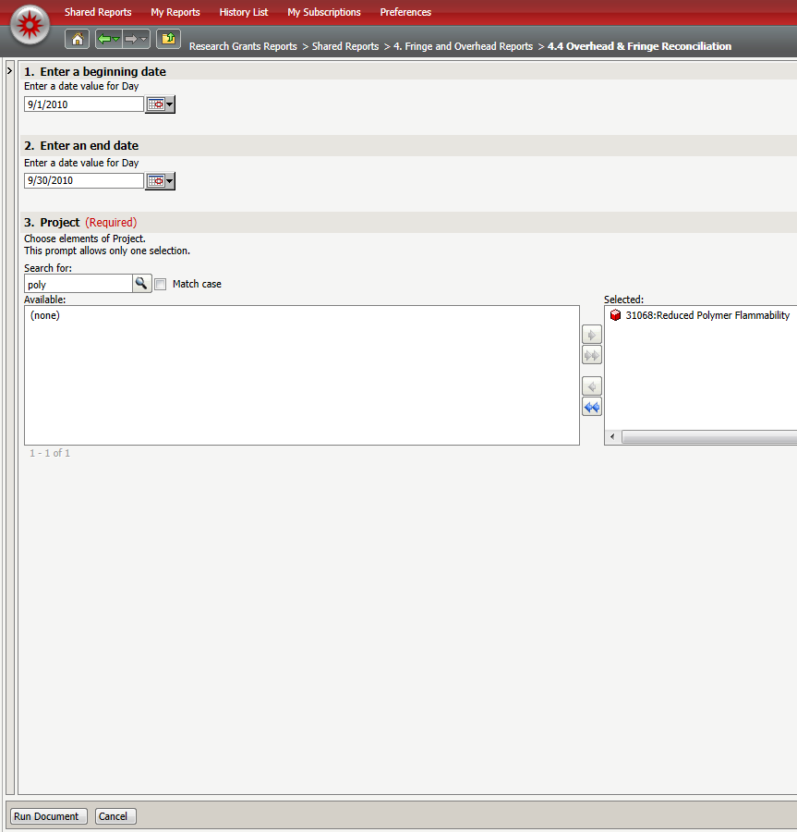
Fringe and Overhead Reports
Enter a Beginning and End date.
Enter the Project Number or Project Name in the Search for box, then click the SEARCH button. Click the RIGHT ARROW button to select the data.
Click RUN REPORT.
Enter the Beginning and End Dates.
Click the RIGHT ARROW button to select the data.
Click the RUN REPORT button to run the report.

Slide 47
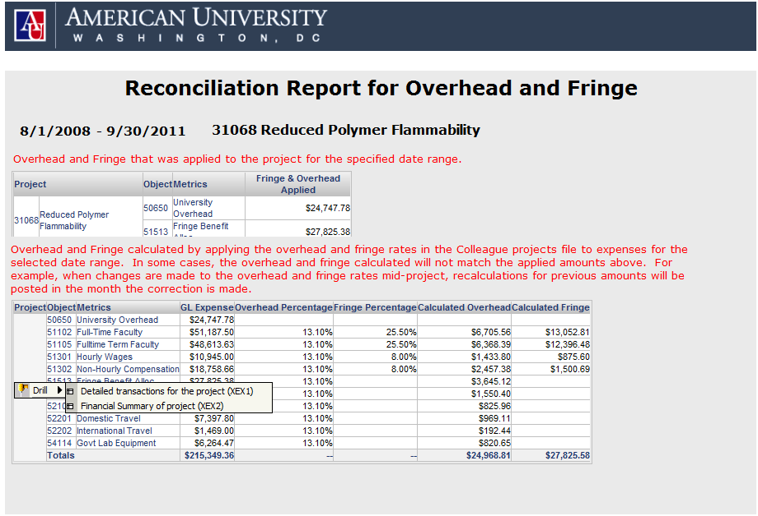
Fringe and Overhead Reports
The Overhead and Fringe data will display.
You may click on the Project field to drill to additional information.

Slide 48
Using the History List
The MicroStrategy History List is a tool that allows you to subscribe to reports on a pre-determined schedule.
Once you have subscribed to a report, the results will run automatically each morning and will be saved in the History List.

Slide 49
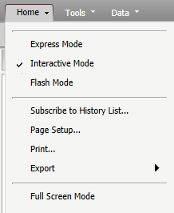
Using the History List
Run a report you would like to have sent to your History List. (You can subscribe a report to the schedule more than once if you would like the same report to be run with different prompt values)
Once the report finishes running, click on the HOME tab, then select the SUBSCRIBE TO HISTORY LIST menu option.
Subscribe to History List

Slide 50
Using the History List
Once the dialog box opens:
  Choose a unique name for the report or accept the default name.
  Choose RESEARCH GRANTS SCHEDULE from the drop-down box
  Expand the ADVANCED OPTIONS menu
    Check the box for “The new report will overwrite older versions of itself” if you do not want to save past results of the report. Uncheck the box if you want to save the results of the report each time it is run.
  Once finished, click OK.

Slide 51
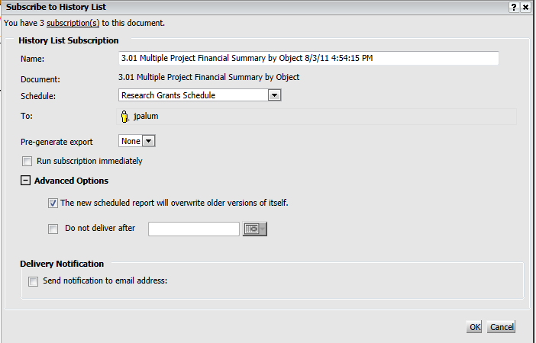
Using the History List
Report Name
Research Grants Schedule
Report will overwrite previous versions

Slide 52
Cost Projection Model
  The MicroStrategy application provides a Cost Projection Model that will allow you to model unobligated funds into the future.
This feature is restricted to users of the system who have a business need to perform aided forecasting.
The Cost Projection Model is available to PC users and MAC users who run Windows.

Slide 53
Cost Projection Model
  The cost projection model will allow you to run MicroStategy reports directly from Microsoft Excel.
  Users of the cost projection model will need to install the MicroStrategy Office component.

Slide 54
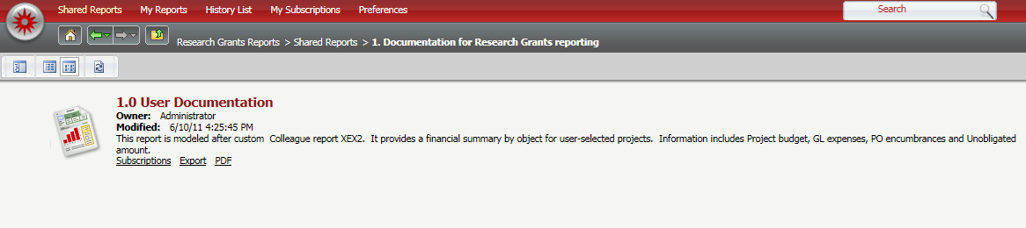
Cost Projection Model
  Click on 1.0 User Documentation.

Slide 55
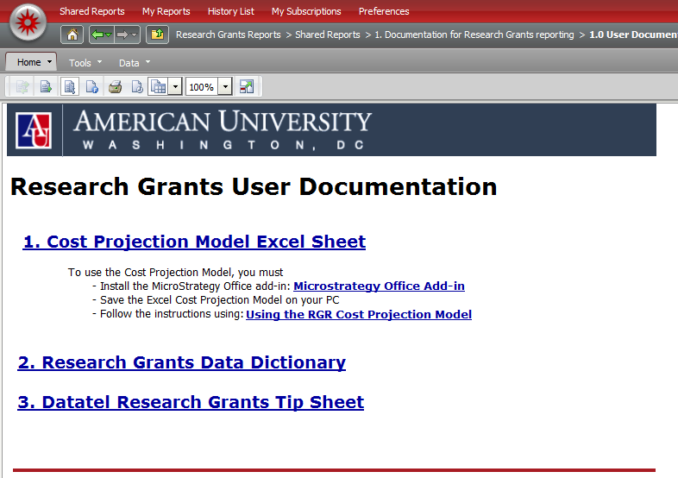
Cost Projection Model
  This page will contain:
  The Cost Projection Model Excel sheet.
  The link to install the MicroStrategy Office add-in.
  The RGR Cost projection user guide.

Slide 56

Cost Projection Model
  Click the COST PROJECTION MODEL EXCEL SHEET link to download and save the Excel spreadsheet to a secure network drive.
  The Excel Sheet will save with the following default name: RGRCostProjectionModel.xls.

Slide 57
Cost Projection Model
  Click the MicroStrategy Office Add-in link to view detailed instructions on how to install the add-in.

Slide 58
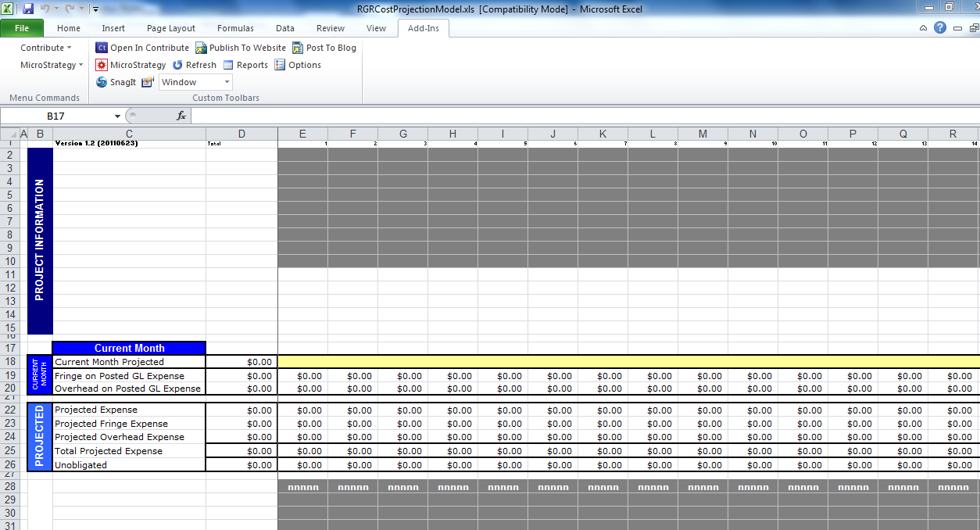
Using the Cost Projection Model
Open the saved RGR Cost Projection Spreadsheet.
You will see three sections with placeholders that will be retrieved from the BI Reporting system. Click the ADD-INS tab.
Add-Ins Tab
Placeholders

Slide 59
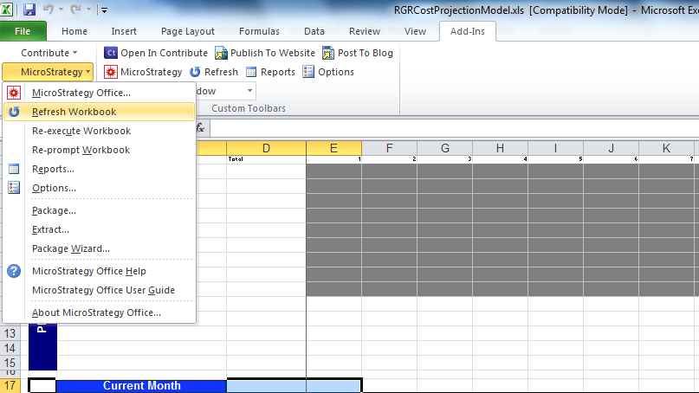
Using the Cost Projection Model
Click the drop-down arrow next to MicroStrategy.
Click REFRESH WORKBOOK.

Slide 60
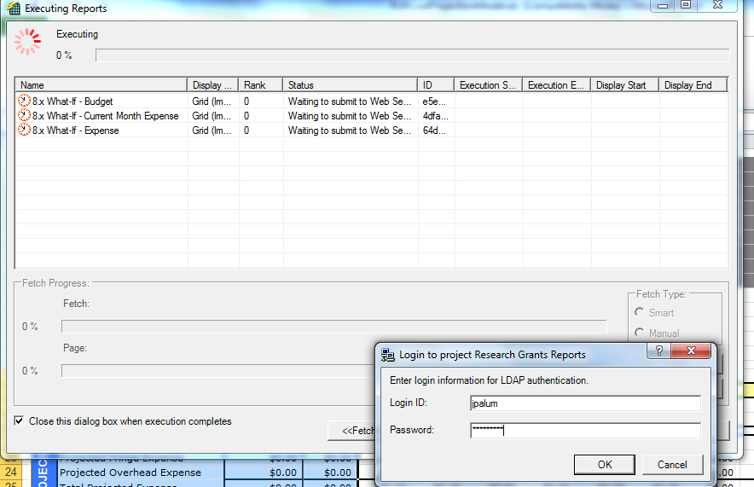
Using the Cost Projection Model
Log on using your my.american.edu username and password.

Slide 61
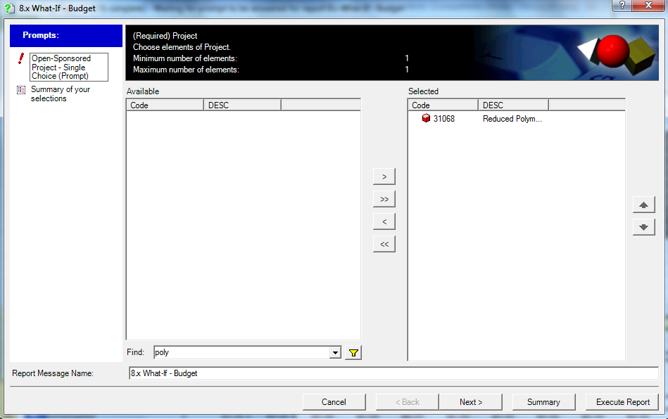
Using the Cost Projection Model
Select a project, click the RIGHT ARROW button to select the data, then, click EXECUTE REPORT to run the report.
Execute Report

Slide 62
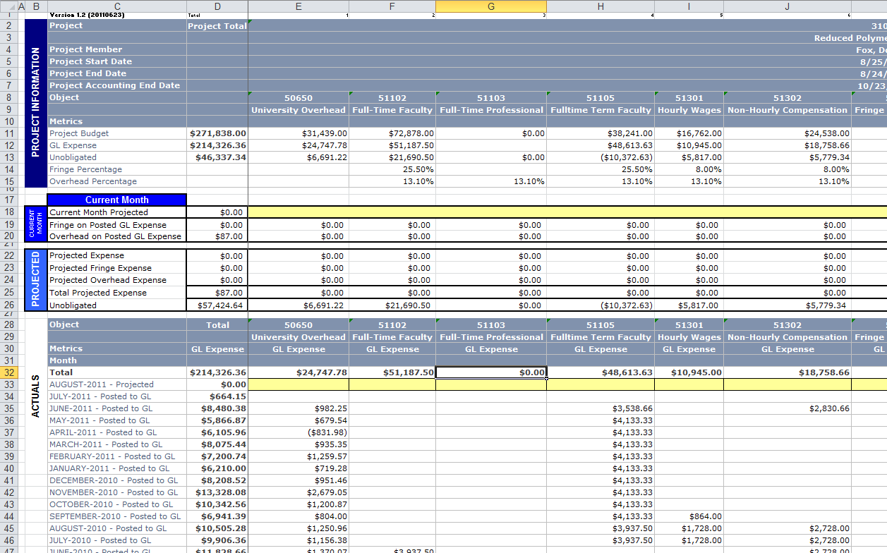
Using the Cost Projection Model
Once the spreadsheet populates, you can enter your projected data in the light yellow cells.
Projected Data
Execute Report

Slide 63
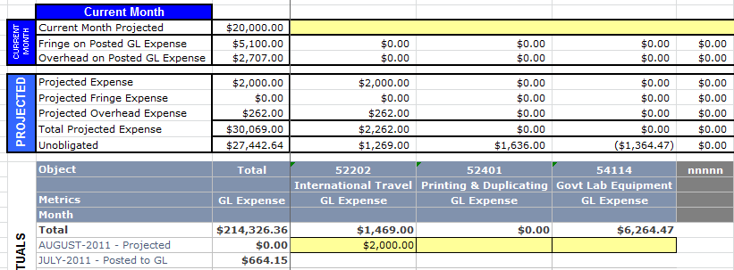
Using the Cost Projection Model
As you enter your projected values for each object for each month, the Projected section will be updated automatically, using the new data being entered.
Projected Expense
Projected Value

Slide 64

Conclusion
Getting Help - IT Help Desk
  helpdesk@american.edu
  202-885-2550
  IM: AskAmericanUHelp
Questions?
Thank you for attending!

