Slide 1

Spring Qualifying Tournament (SQT) 2021
INFORMATION SESSION
https://www.wcl.american.edu/community/students/competition-teams/mootcourt/competitions/spring-qualify/

Slide 2
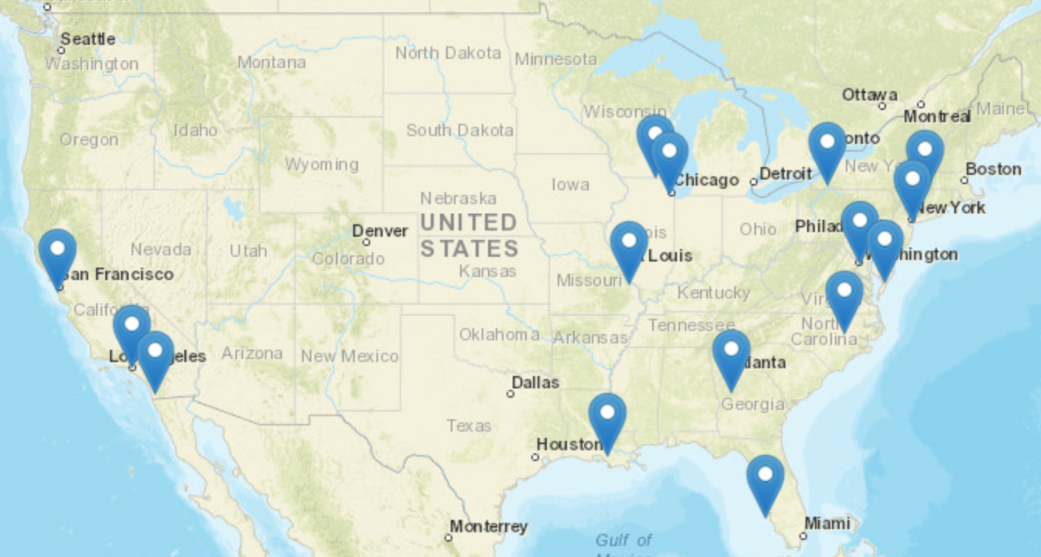
Moot Court Basics
Simulated appellate proceedings. Participants write a brief for one party, and then present oral arguments for both sides before panels of three judges.
New York, Los Angeles, San Francisco, New Orleans, Chicago, Tampa Bay, Miami, Atlanta, St. Louis, and many more!
And let’s not forget our competitors representing us in Vienna!

Slide 3
Team Requirements
Compete in one competition per year
Enroll in Appellate Advocacy
Log hours (86 per year)
Work the four tournaments we host
  Wechsler First Amendment Moot Court Competition – Fall 2021
  Alvina First Year Moot Court Competition – January 2022
  Spring Qualifying Tournament – February 2022
  Jessup Regional Tournament – Spring 2022

Slide 4
Why Moot Court?
Your Resume – employers see legal research, writing, and analysis skills
Experience working with judges and practitioners
Develop oral advocacy skills
Compete against other talented students from around the country (or globe!)
It’s fun!

Slide 5
The Spring Qualifying Tournament (SQT)
Two Components
  Brief Writing
    Limited universe
    2,000 words
    Write for either Appellant or Appellee
  Oral Arguments
    Argue twice
      One on brief
      One off brief
    15 minutes per argument

Slide 6
Competition Timeline
Jan. 19: Registration Opens
Jan. 28: Registration Closes at
11:59pm
Jan. 30: Problem Released
Must go to one mandatory information session, not both.
Jan. 31 Mandatory Info Session @ Noon (zoom)
Feb. 01: Mandatory Info Session @ 10PM (zoom)
Feb. 07: Briefs Due at
11:59pm
Feb. 13: Oral Arguments

Slide 7
Oral Argument Schedule Overview
Saturday, February 13th
One argument in the morning
  Typically on brief
One argument in the afternoon
  Typically off brief

Slide 8
QUESTIONS?
mootcourtsqt@gmail.com

